Slide 1
Title: Software Development Life Cycle (SDLC) Case Study: Online Shopping Application

Slide 2
Introduction to SDLC
Content: Software Development Life Cycle (SDLC) is a structured process used to develop high-quality software systematically. It defines a set of steps that include planning, designing, developing, testing, and maintaining software.
SDLC helps:
Improve software quality
Reduce development cost
Complete project on time
Case Study: We are developing an Online Shopping App (like Amazon/Flipkart) where users can browse, purchase, and track products.

Slide 3
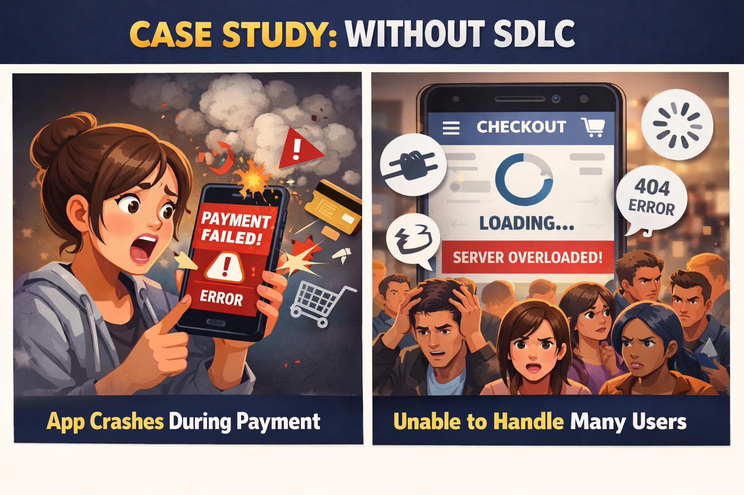
Need of SDLC
Case Study: Without SDLC, the shopping app may crash during payment or fail to handle many users.
Content: Without SDLC:
Projects may fail
Budget may exceed
Software may have many bugs
With SDLC:
Proper planning
Clear requirements
Organized development

Slide 4
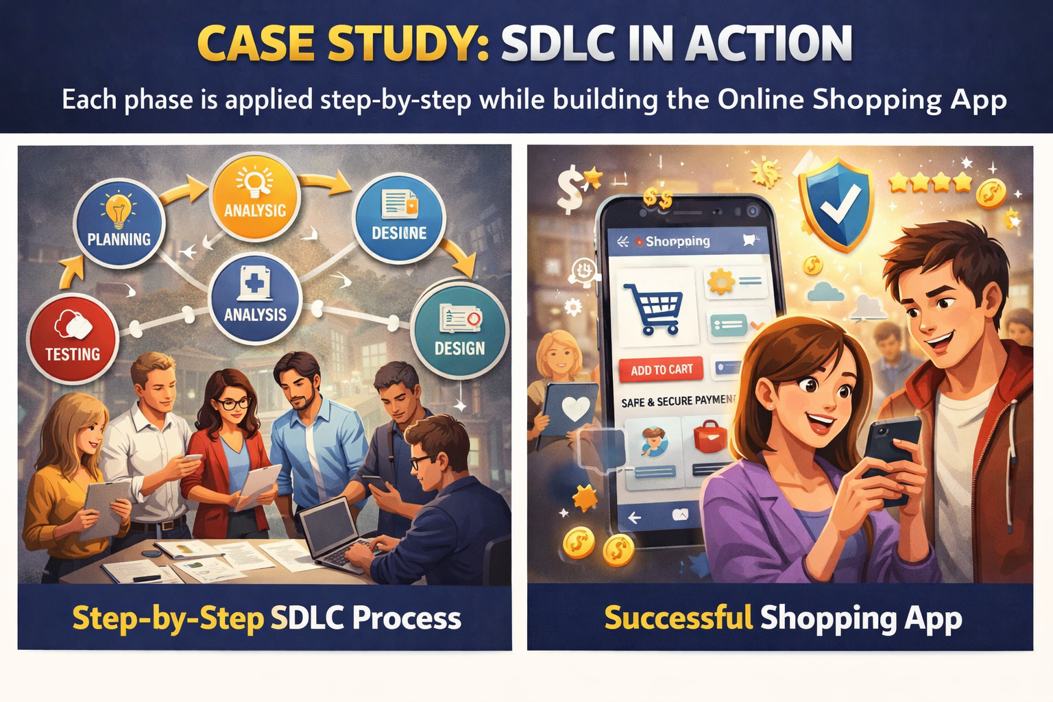
Phases of SDLC
Case Study: Each phase is applied step-by-step while building the Online Shopping App.
Main phases:
Planning
Requirement Analysis
System Design
Development
Testing
Deployment
Maintenance

Slide 5
Planning Phase
Define project objectives
Identify target users
Estimate budget & timeline
Risk analysis
Case Study: Company plans:
Target users: Online buyers
Budget: ₹10 lakh
Timeline: 6 months
Risk: Payment failure, server crash

Slide 6
Requirement Analysis
Types of requirements:
Functional (what system does)
Non-functional (performance, security)
Examples:
Login system
Fast loading speed
Case Study: Functional:
Add to cart
Payment system
Non-functional:
Secure transactions
App loads in <3 seconds

Slide 7
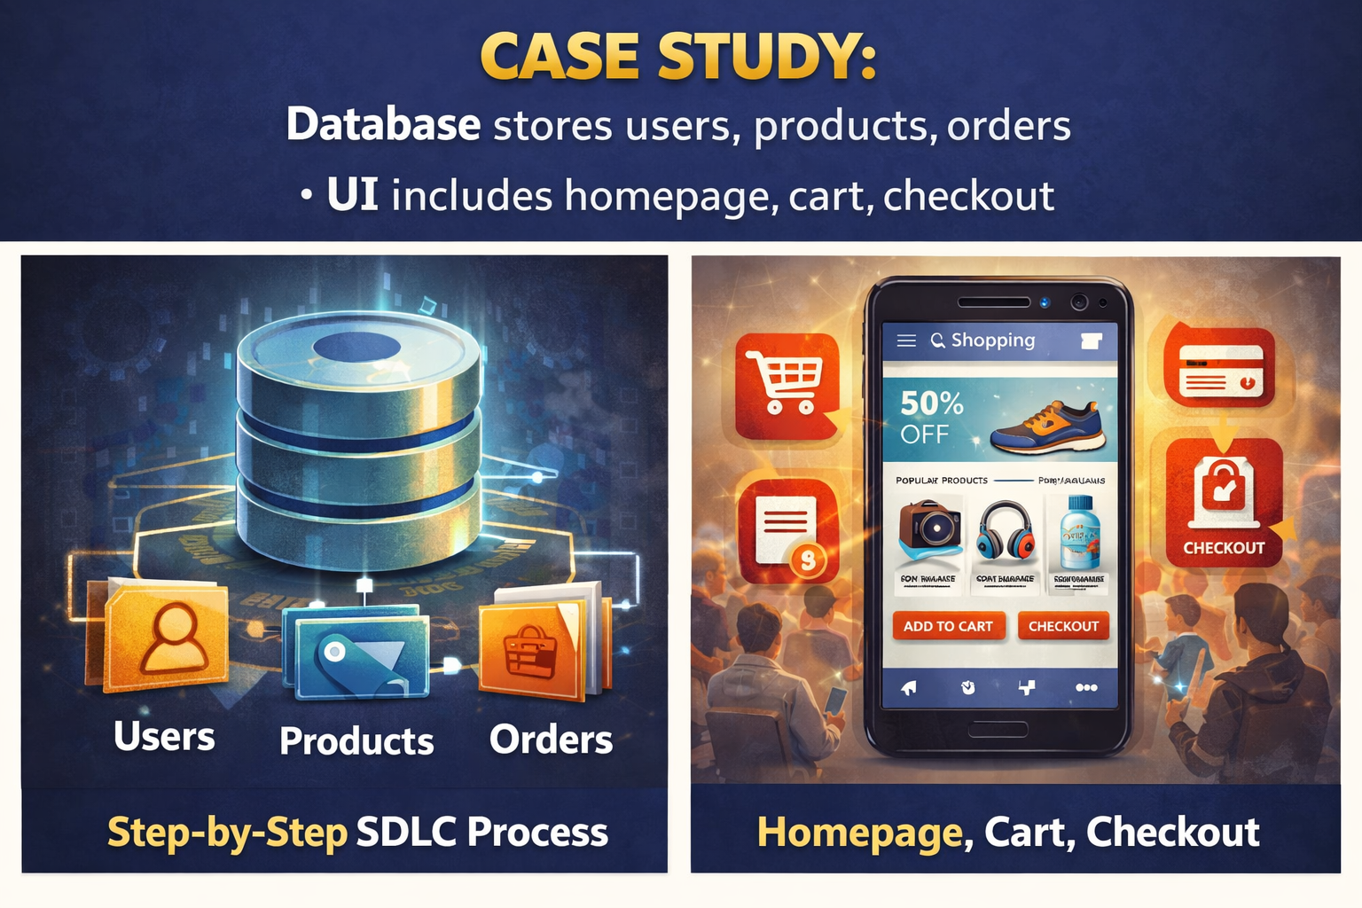
System Design
Case Study:
Database stores users, products, orders
UI includes homepage, cart, checkout
High-Level Design (Architecture)
Low-Level Design (Database, UI)
Includes:
Database structure
User interface design

Slide 8
Development Phase
Developers write code
Use programming languages
Follow design documents
Case Study:
Frontend: HTML, CSS, JavaScript
Backend: Node.js / PHP
Database: MySQL

Slide 9
Testing Phase
Types of testing:
Unit Testing
Integration Testing
System Testing
Goal:
Find and fix bugs
Case Study:
Check login errors
Test payment gateway
Verify cart functionality

Slide 10
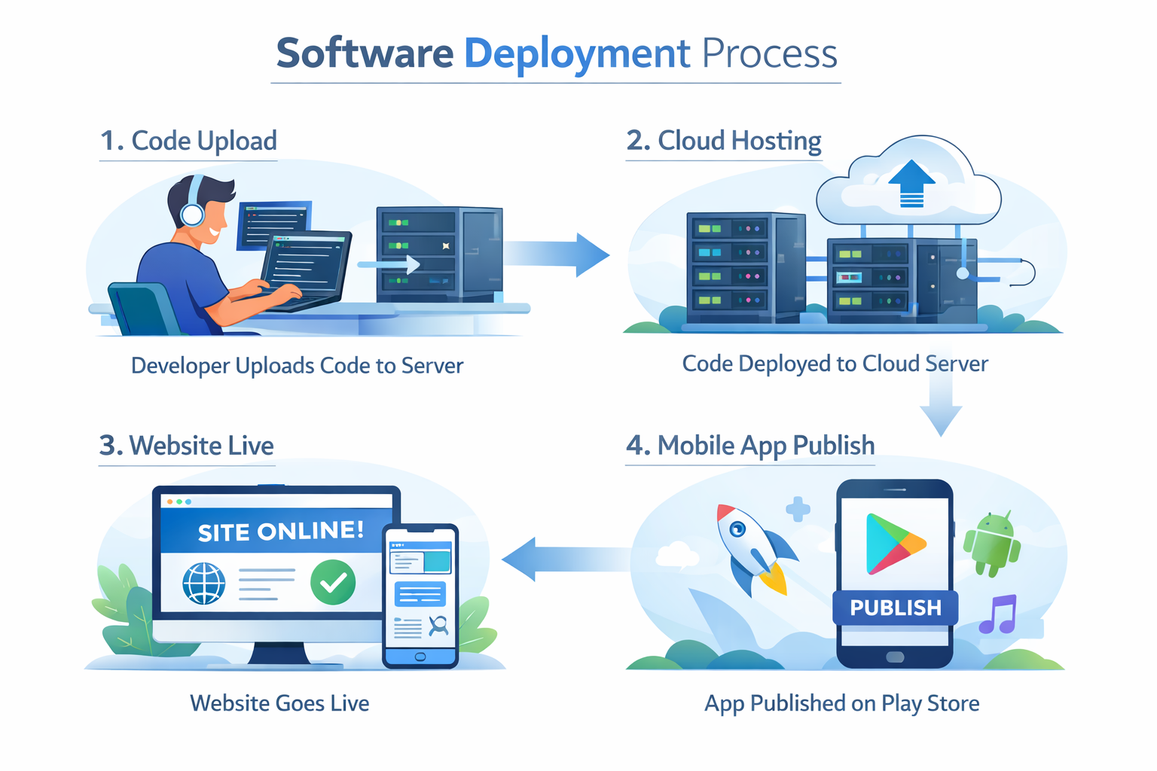
Deployment Phase
Case Study: Shopping app is:
Uploaded to server
Made live on website
Published on Play Store
Deployment is the phase where the software is released and made available to users. After successful testing, the application is installed on servers and becomes live.
Key Activities in Deployment:
Final version release
Server setup and configuration
Database connection setup
Domain hosting and live access
App publishing (if mobile application)

Slide 11
Maintenance Phase
Case Study:
Add discount coupons
Fix payment bugs
Improve app speed
Bug fixing
Performance improvement
Feature updates

Slide 12
SDLC Models Overview
Popular SDLC models:
Waterfall
Agile
Spiral
Each model has different approach.
Case Study: E-commerce apps mostly use Agile Model for continuous updates.

Slide 13
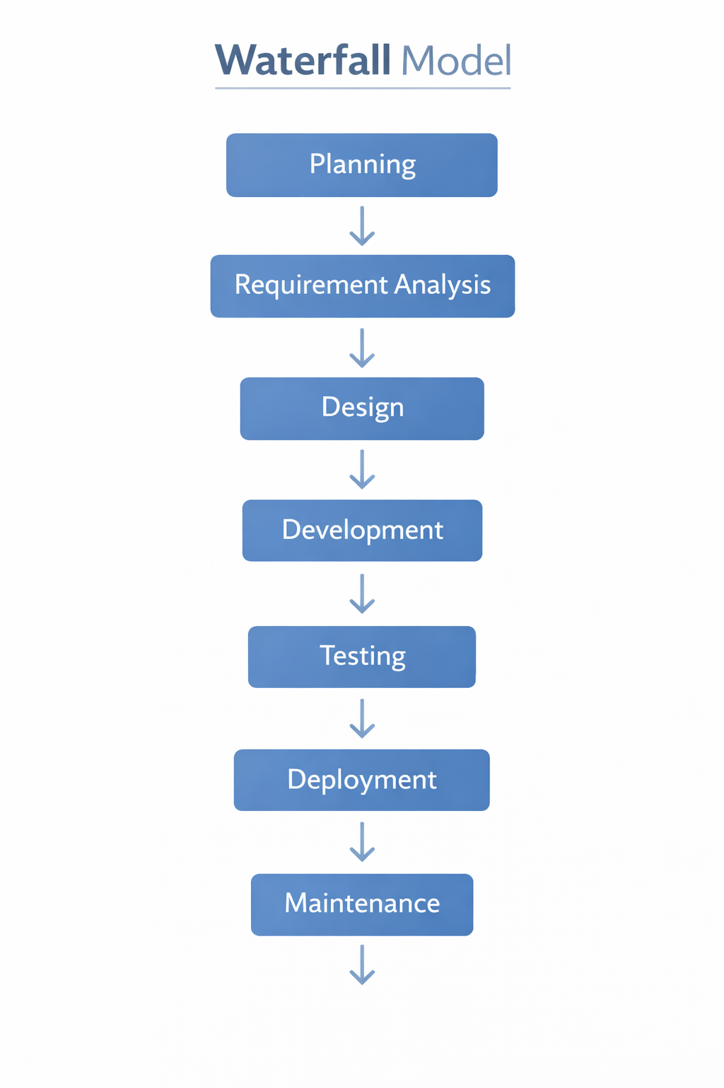
Waterfall Model
Linear and sequential
One phase at a time
No changes after completion
Advantages:
Simple and easy
Disadvantages:
Not flexible

Slide 14
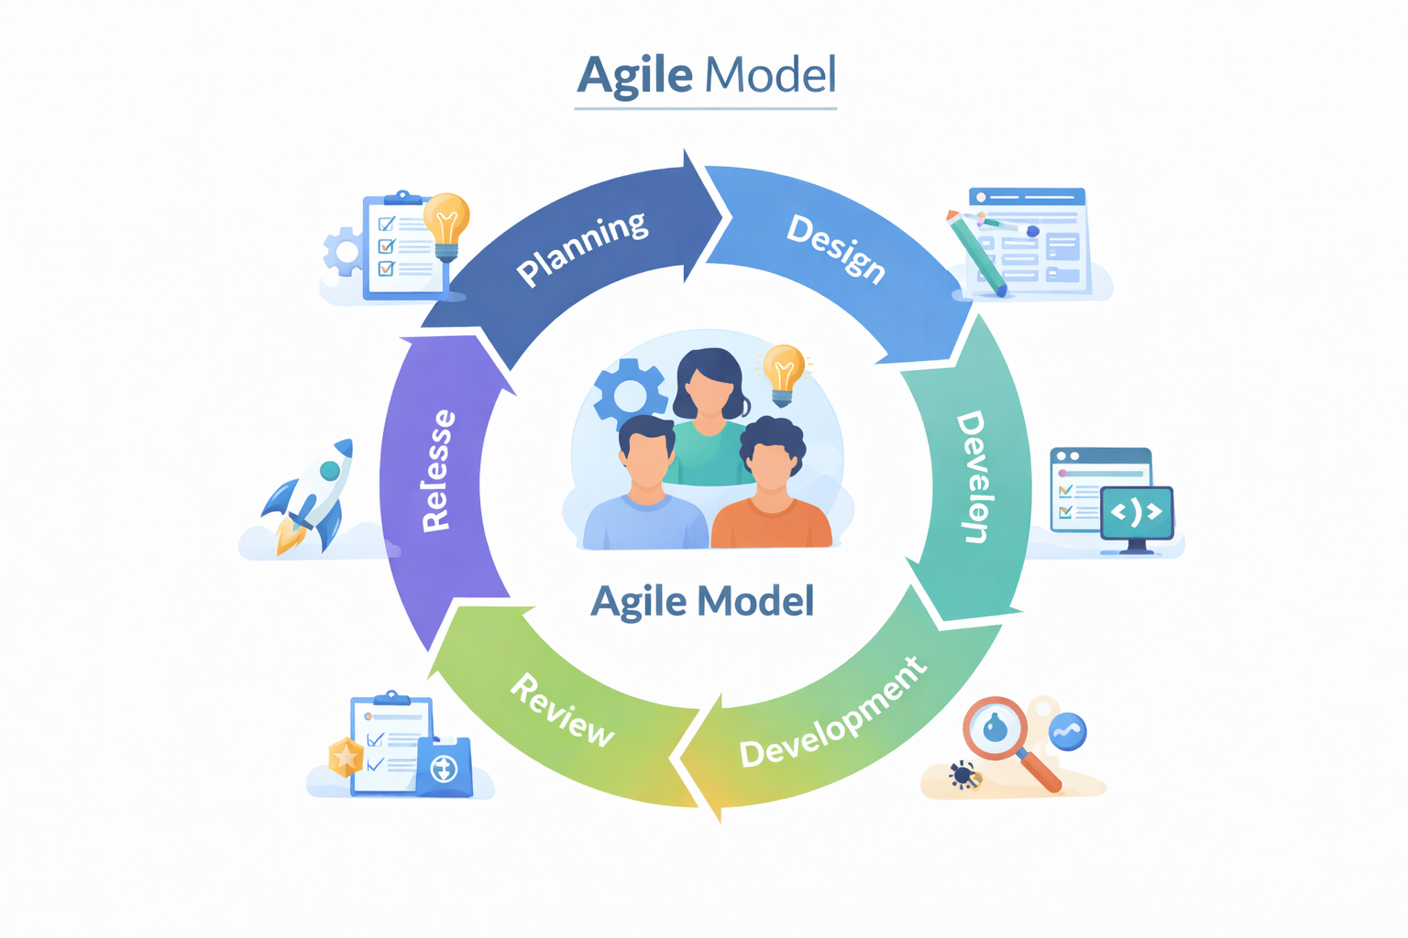
Agile Model
Case Study:
Weekly updates
Add new features like wishlist, offers
Iterative development
Work in small cycles (sprints)
Continuous feedback
Advantages:
Flexible
Fast updates

Slide 15
Spiral Model
Case Study: Online Shopping App
In our shopping app:
Risk Identification: Payment failure, data theft, server crash
Risk Analysis: Analyze security issues in online transactions
Solution:
Implement secure payment gateway
Use encryption (HTTPS)
Add OTP verification
Result:
Secure transactions
Reduced fraud risk
Increased user trust
The Spiral Model is an advanced SDLC model that focuses on risk analysis and continuous improvement. It combines features of both Waterfall (structured approach) and Iterative model (repeated cycles).

Slide 16
Advantages of SDLC
Software Development Life Cycle (SDLC) provides a systematic and organized way to develop software. It ensures that every stage of development is properly planned, executed, and tested.
Case Study: Online Shopping App
Users get:
Secure Payments: Safe transaction methods like OTP and encryption
Smooth Experience: Fast loading, easy navigation, and user-friendly interface
Reliable System: Less crashes and better performance
Regular Updates: New features like offers, wishlist, etc.

Slide 17
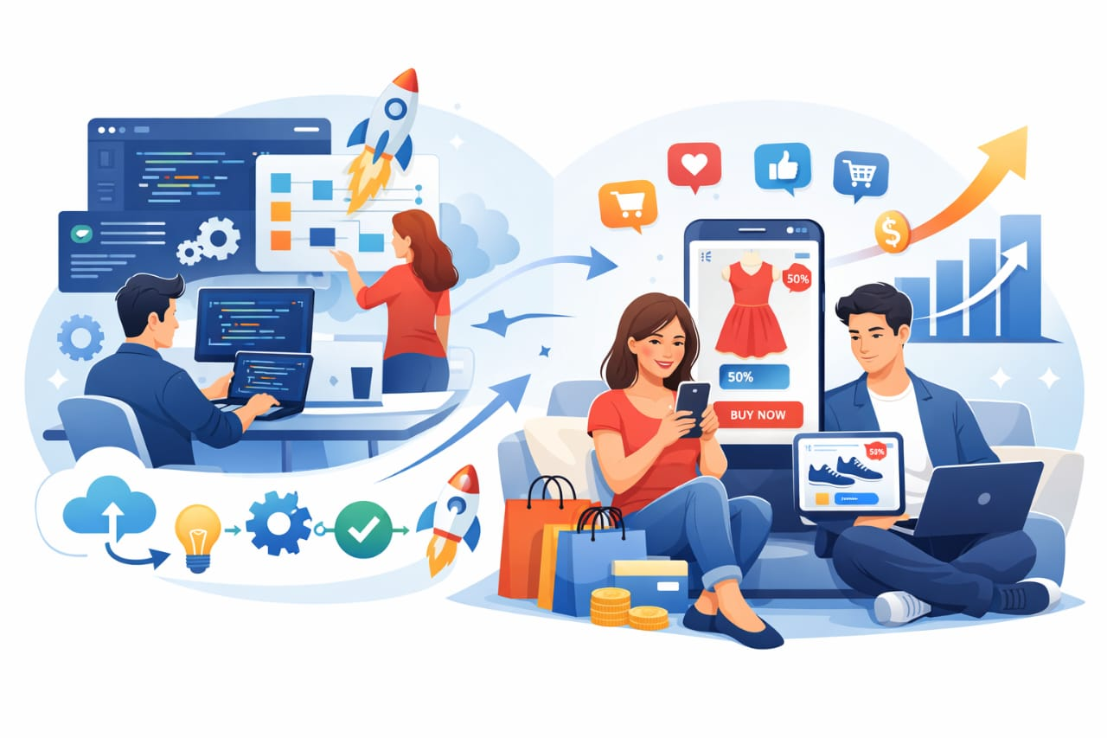
Conclusion
SDLC is essential for developing efficient and reliable software systems.
Case Study: Online Shopping App becomes:
User-friendly
Secure
Successful

